Slide 1
Profit From Funeral Industry Trends
Kathy Dudley AIFSE

Slide 2
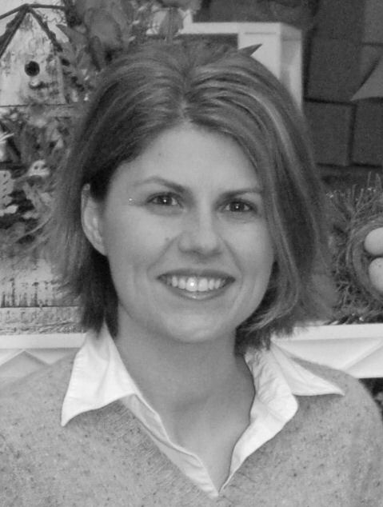
Kathy Dudley AIFSE
Kathy Dudley has an MBA from the Manderson Graduate School of Business (The University of Alabama) and extensive industry experience as a retail flower shop owner.
She is also an active member of SAF:
• Chairman of the Floral Management
Magazine Committee
• Member of the Retail Council
• SAF Convention Presenter.
Kathy is currently Business Manager
of Floral Strategies.

Slide 3
Trends in The Funeral Industry
Increased Personalization
• As unique as the person who died. Examples include theme caskets, services on a golf course, etc.

Slide 4
Trends in The Funeral Industry
Increased Personalization
• As unique as the person who died. Examples include theme caskets, services on a golf course, etc.
Stock up on personalized items such as golf tees and old clubs, fishing lures and poles, garden gloves and watering cans, packs of cards, poker chips, etc.

Slide 5
Trends in The Funeral Industry
Advance Funeral Planning
• Pre-plan and/or pre-pay. Allows for choice of music, readings, setting, time of day, incorporate hobbies, etc... plus - alleviates stress on loved ones.

Slide 6
Trends in The Funeral Industry
Advance Funeral Planning
• Pre-plan and/or pre-pay. Allows for choice of music, readings, setting, time of day, incorporate hobbies, etc... plus - alleviates stress on loved ones.
Talk to your funeral director. Are they talking
about flowers when they pre-plan? How
can you assist them in this?

Slide 7
Trends in The Funeral Industry
Cremations on the Rise
• Partially economically driven.
Prices as low as 1/5th the cost
of traditional funeral.

Slide 8
Trends in The Funeral Industry
Cremations on the Rise
• Partially economically driven.
Prices as low as 1/5th the cost
of traditional funeral.
Make a Cremation Portfolio

Slide 9
Trends in The Funeral Industry
Technology Playing Larger Role
• Websites, online obituaries and guestbooks, even online memorial broadcasts.

Slide 10
Trends in The Funeral Industry
Technology Playing Larger Role
• Websites, online obituaries and guestbooks, even online memorial broadcasts.
Distance often means less flowers. Offer alternatives to fresh flowers, more keepsakes. Get involved with listings and ads/sponsorships on FH websites.

Slide 11
Trends in The Funeral Industry
Green Funerals
• Sometimes lower cost but not always.

Slide 12
Trends in The Funeral Industry
Green Funerals
• Sometimes lower cost but not always.
• Often goes hand in hand with Cremation, no embalming, biodegradable caskets for burials, small gatherings in natural setting.

Slide 13
Trends in The Funeral Industry
Green Funerals
• Sometimes lower cost but not always.
• Often goes hand in hand with Cremation, no embalming, biodegradable caskets for burials, small gatherings in natural setting.
Use Organic materials, containers. Natural style arrangements, offer alternatives such as trees, perennials, garden stones.

Slide 14
Trends in The Funeral Industry
New Face of the Profession
• Fewer family run Funeral Homes.

Slide 15
Trends in The Funeral Industry
New Face of the Profession
• Fewer family run Funeral Homes.
• The top 4 publicly-traded funeral home operators in the U.S. accounted for approximately 10% of market share in 2009.

Slide 16
Trends in The Funeral Industry
New Face of the Profession
• Fewer family run Funeral Homes.
• The top 4 publicly-traded funeral home operators in the U.S. accounted for approximately 10% of market share in 2009.
• More women entering this field.

Slide 17
Trends in The Funeral Industry
New Face of the Profession
• Fewer family run Funeral Homes.
• The top 4 publicly-traded funeral home operators in the U.S. accounted for approximately 10% of market share in 2009.
• More women entering this field.
Expect more professionally run funeral homes with a sharper eye on profit. The network will be continually changing.

Slide 18
Trends in The Funeral Industry
What Do Funeral Directors Want to See?

Slide 19
Trends in The Funeral Industry
What Do Funeral Directors Want to See?
• Deliver on Time

Slide 20
Trends in The Funeral Industry
What Do Funeral Directors Want to See?
• Deliver on Time
• Be Courteous

Slide 21
Trends in The Funeral Industry
What Do Funeral Directors Want to See?
• Deliver on Time
• Be Courteous
• Make Sure Flowers Are Secure

Slide 22
Trends in The Funeral Industry
What Do Funeral Directors Want to See?
• Deliver on Time
• Be Courteous
• Make Sure Flowers Are Secure
• Watch Your Sizing

Slide 23
Trends in The Funeral Industry
What Do Funeral Directors Want to See?
• Watch Your Weight

Slide 24
Trends in The Funeral Industry
What Do Funeral Directors Want to See?
• Watch Your Weight
• Make Flowers Like the Picture

Slide 25
Trends in The Funeral Industry
What Do Funeral Directors Want to See?
• Watch Your Weight
• Make Flowers Like the Picture
• Put A Good Description on Back of Card

Slide 26
Trends in The Funeral Industry
What Do Funeral Directors Want to See?
• Watch Your Weight
• Make Flowers Like the Picture
• Put A Good Description on Back of Card
• Include Senders Name and Address

Slide 27
Trends in The Funeral Industry
What Do Funeral Directors Want to See?
• Use Typed Cards, in a Clear Font, able to be read 3 feet away. Times New Roman or Arial are great fonts, size 12 to 14 is ideal.

Slide 28
Trends in The Funeral Industry
What Do Funeral Directors Want to See?
• Use Typed Cards, in a Clear Font, able to be read 3 feet away. Times New Roman or Arial are great fonts, size 12 to 14 is ideal.
• Offer to Help Deliver to Cemetery or Home

Slide 29
Trends in The Funeral Industry
What Do Funeral Directors Want to See?
• Use Typed Cards, in a Clear Font, able to be read 3 feet away. Times New Roman or Arial are great fonts, size 12 to 14 is ideal.
• Offer to Help Deliver to Cemetery or Home
• Don’t Use Old Flowers

Slide 30
Summary
• Communication with your Funeral Directors is paramount to future success.

Slide 31
Summary
• Communication with your Funeral Directors is paramount to future success.
• Offer alternatives to meet the changing demands and desires of today’s funeral customer.

Slide 32
Thank You For Participating
For more information about Kathy Dudley and Floral Strategies please visit www.floralstrategies.com or call 800.983.6184

Slide 33
Thank You For Participating
For more information about Kathy Dudley and Floral Strategies please visit www.floralstrategies.com or call 800.983.6184
For related materials and information on future webinars please visit www.floristware.com/classroom.

Slide 34
Thank You For Participating
For more information about Kathy Dudley and Floral Strategies please visit www.floralstrategies.com or call 800.983.6184
For related materials and information on future webinars please visit www.floristware.com/classroom
Also - please stay in touch by “Liking” FloristWare on Facebook and following FloristWare on Twitter

